Slide 1

BookBoxBook
-Final Presentation-
북박북
북박북
team
Go
Na
Mi
Notes:
여기서 설명 간단히 한 줄 정도 할깡..?

Slide 2
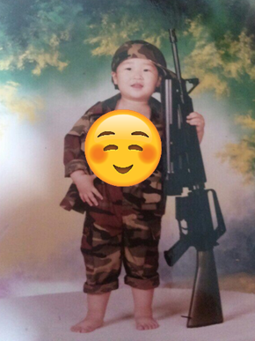
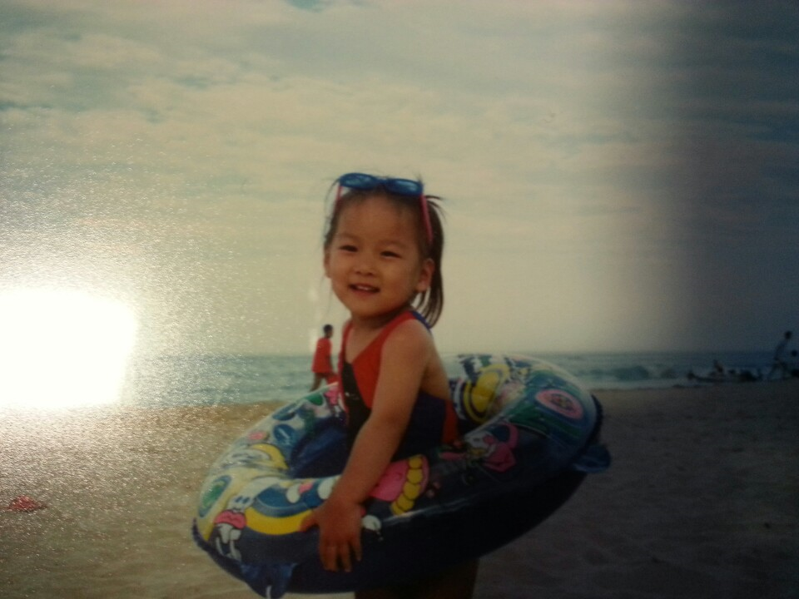
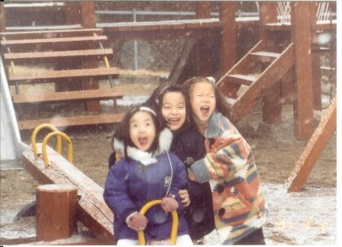
Go
Na
Mi
Hoyun
Yuseon
Seungyun
-Main Function of Service
(App)
-Server
-Main Function of Service
-Hardware
-Design of Application
Notes:
고나미는 고호윤, 남유선, 이승윤 각각의 성을 따서 만든 팀 이름

Slide 3
01
What is B.B.B
02
Why B.B.B
CONTENTS
03
Final Demo
04
Wrap up

Slide 4
What is
B
B
B

Slide 5





B
ook
B
ox
BBB
B
ook
Apppication
BookBox
Integrated service for trading used books between univ. students

Slide 6
Why
B
B
B

Slide 7
About 85% have sold/bought used books
Based on Research of
71 University Students…
About 70% have experienced in process
inconvenience

Slide 8
inconvenience
was…
31%
contact
Way seller and buyer each other
23%
Meeting stranger
could be dangerous
14%
Way sellers and buyers
send and receive money
7%
Risk of
leak of Personal information

Slide 9
Do not have to
Simple Way
contact
send and receive money
No need of
Low Risk of
Meeting stranger
leak of Personal information

Slide 10
FINAL
DEMO

Slide 11
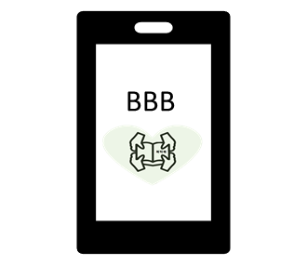

DEMO
Register Book
My Sell List
Check My Rate
Get Push Alarm
seller

Slide 12
DEMO
Buy Book
Pay
My Buy List
Rate Seller
Report Poblems
Get Push Alarm
buyer

Slide 13
DEMO
Recognize QR & ISBN
Put Books
Lock/Unlock Box
seller

Slide 14
DEMO
Recognize QR
Take Books
Lock/Unlock Box
buyer

Slide 15
Wrap up

Slide 16



BookBoxBook
Project Name
:
some details
Degree
Of
Completeness
:
App
Accomplish almost of plan
Exception Handling
Good UX/UI
Completeness
(upgraded materials)
BookBox
Accomplish all plans
Exception Handling

Slide 17
I was worried at first. However, 14weeks passed so fast. Though it was tough time, I feel rewarding after all.
Hoyun
I promised myself that I’m never gonna do hardware!!
Why did I do it again…? It was so confusing and harsh time.
But I am soooo proud of myself that I complete this!
Good luck with your next Capstone project Hoyun XD
Yuseon
Seungyun
Happy that the project finaaalllyyy ends!
I was so lucky to be a member of GoNaMi
Thank you Hoyun and Yuseon :D

Slide 18
Thank you

